Slide 1
69
Discrete Mathematics
Principle of Inclusion-Exclusion

Slide 2














Slide 3

























Slide 4








Notes:
142+90-12=220
42+15-8=49

Slide 5




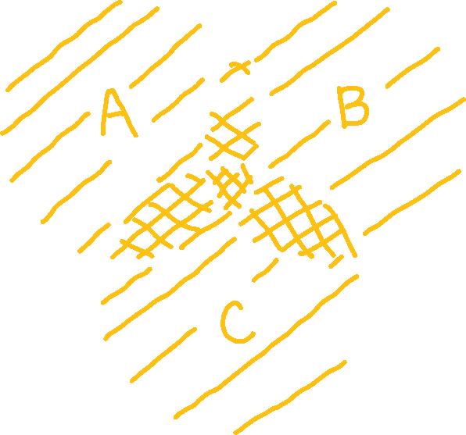








Slide 6




Notes:
7! + 8! + 7! - 5! - 4! - 5! + 2! = 50,138

Slide 7






Slide 8
Up Next…
Introduction to Relations

